Slide 1
Crimson Clubs (Design)
Adam Gabriel, Travis Redfield, Taylor Meads,
Maclane May, Max Livingston

Slide 2
Recap
Manage clubs and teams
Receive push notifications to your phone
View calendar of events

Slide 3
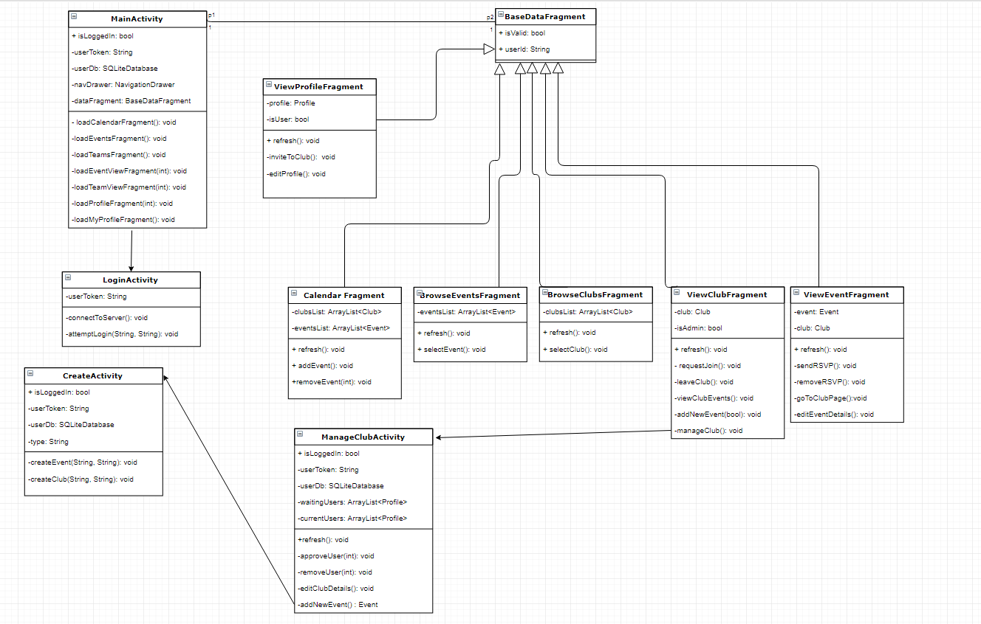
Class Diagram

Slide 4
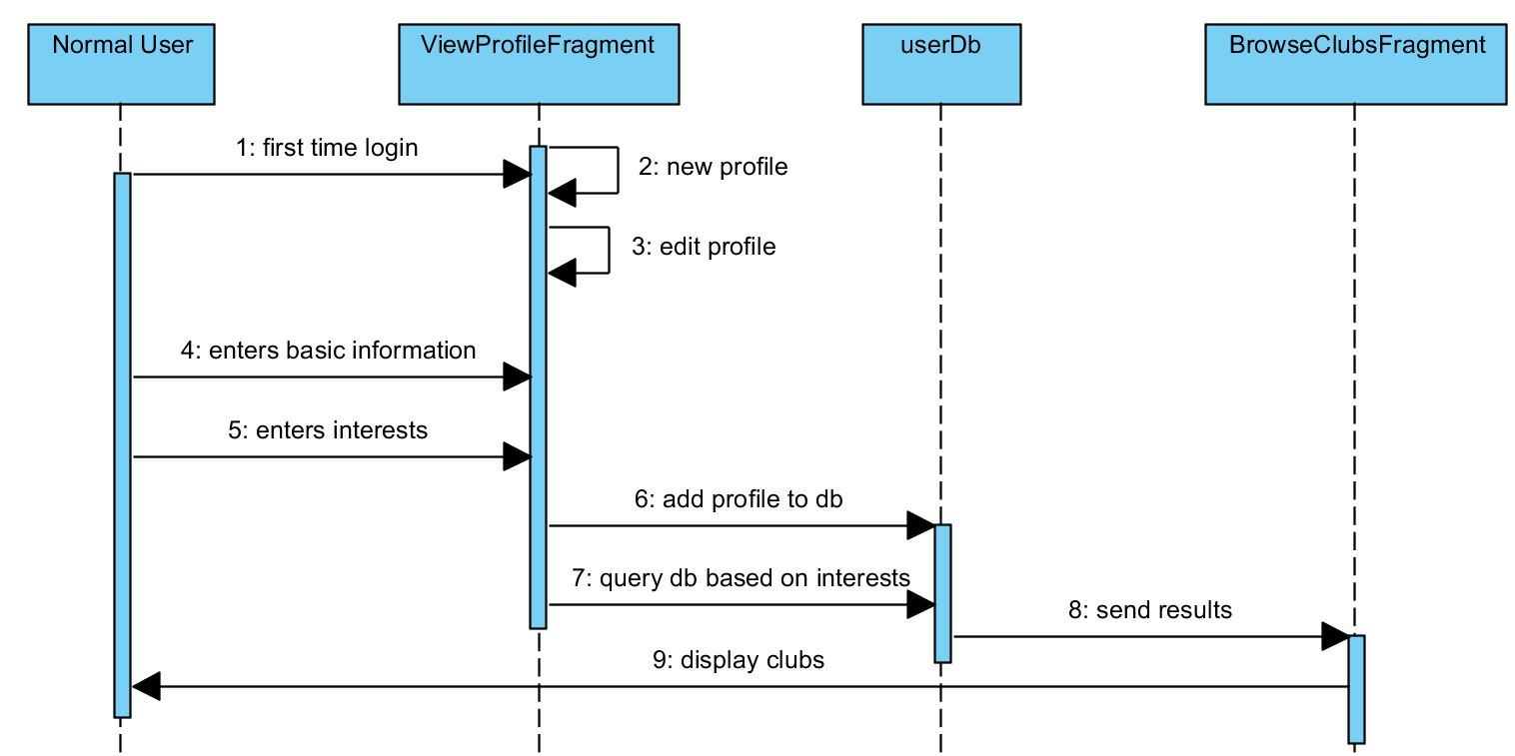
Create Profile

Slide 5
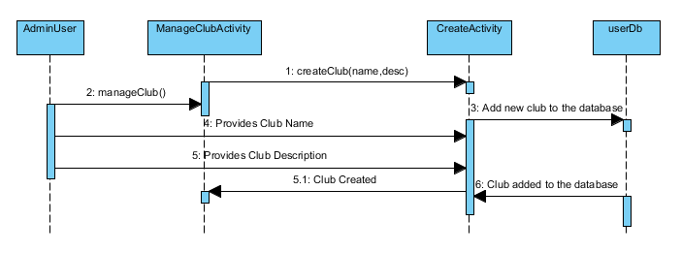
Create Club

Slide 6
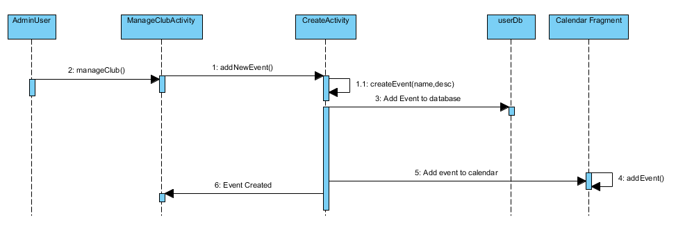
Create Event

Slide 7
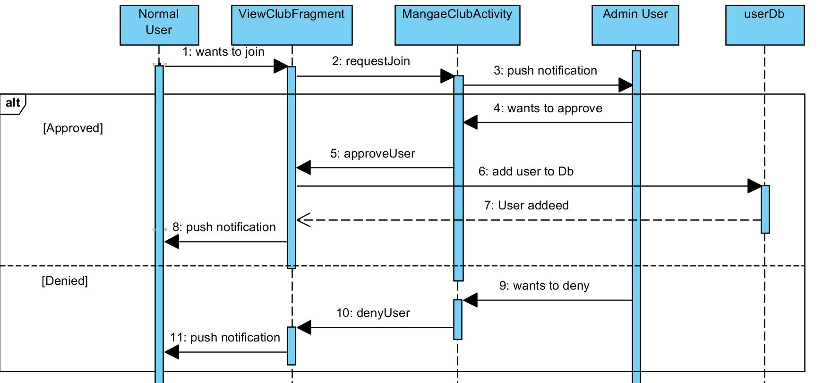
Join Club

Slide 8
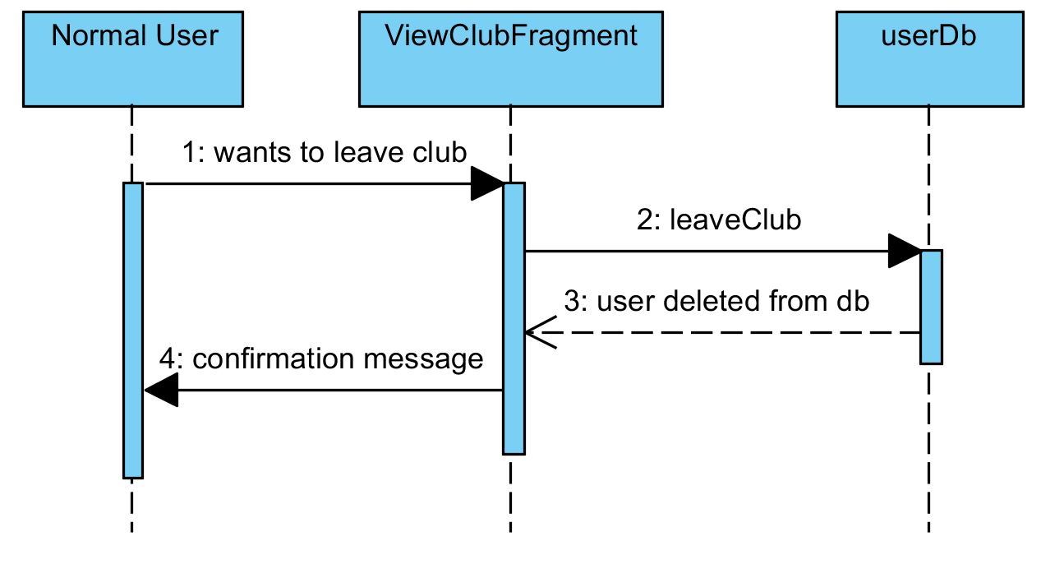
Leave Club

Slide 9
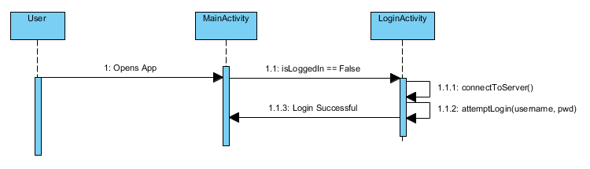
Login Activity

Slide 10
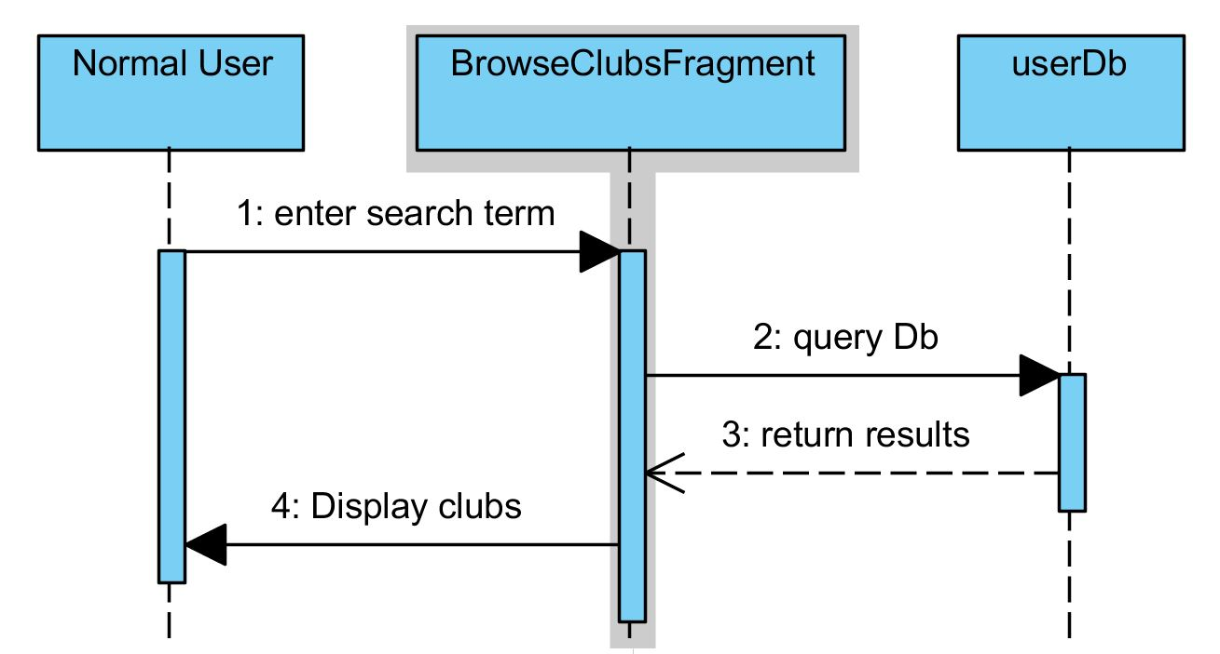
Search Clubs

Slide 11
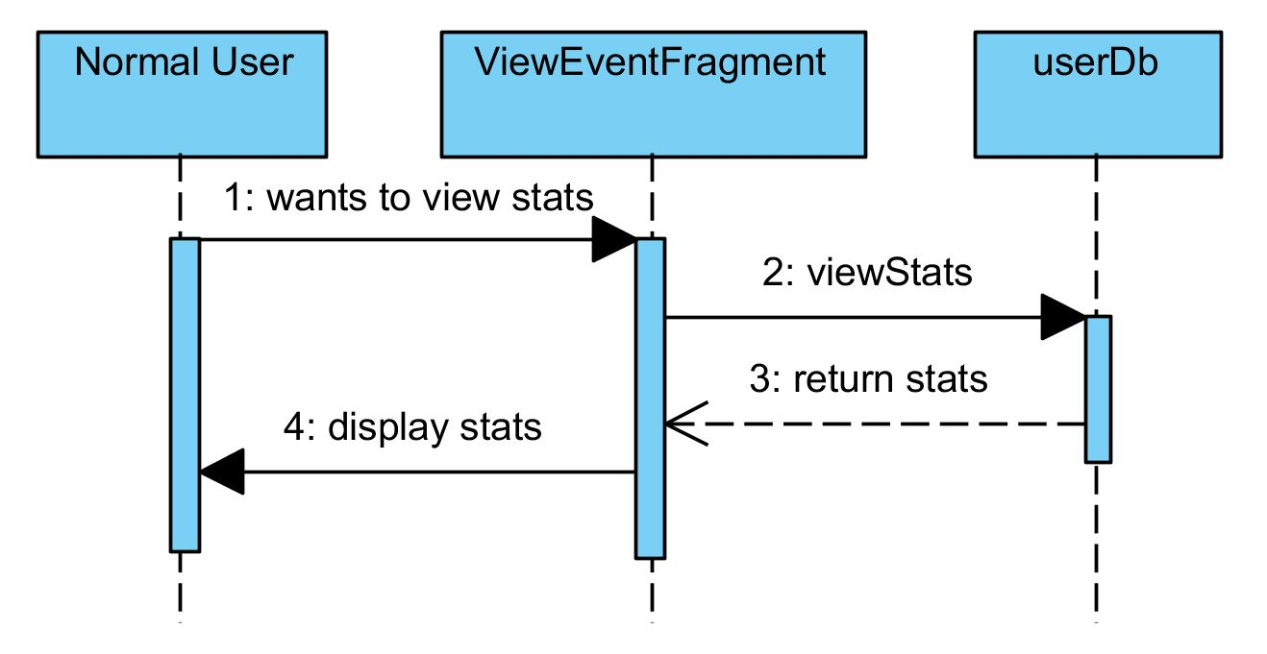
View Event Statistics

Slide 12
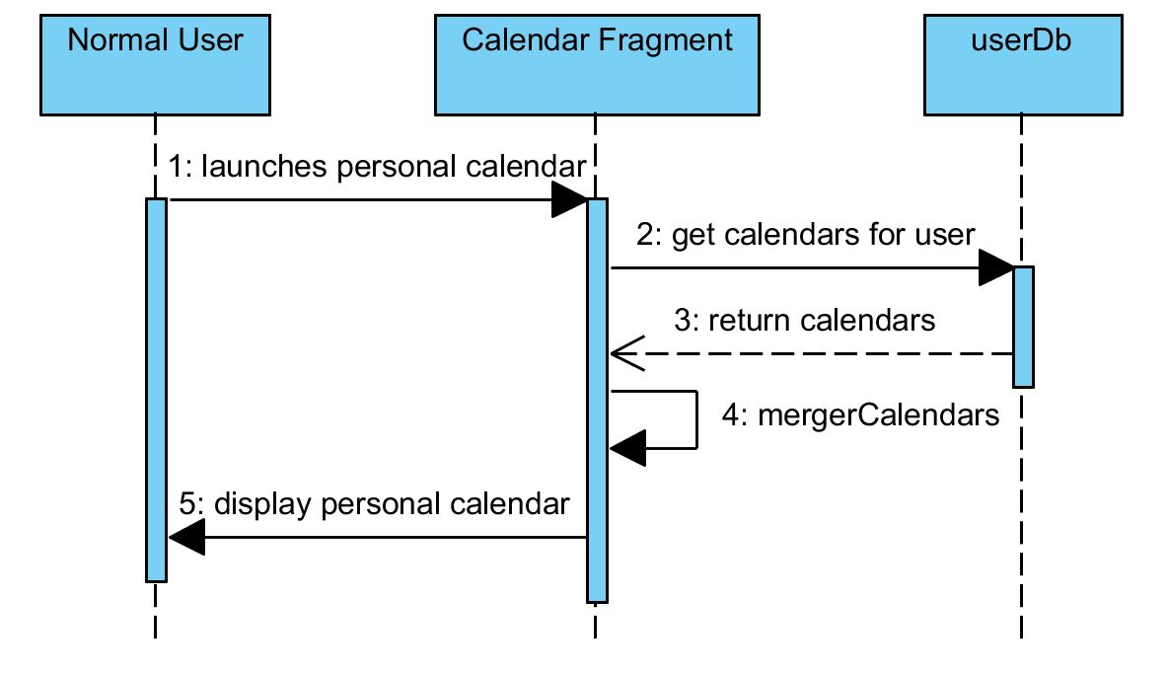
View Calendar

